Slide 1
ST5188 Project Proposal: Consultation Session 1
Applications of Graph Convolution Networks in Recommender Systems
Project Group 14:
Yeo Ming Jie, Jonathan
Chen Pu
Shi Qin

Slide 2



Recommender Systems and Classical Approaches
Collaborative Filtering
Based on the principle that users that behave similarly would have similar preferences
Recommend items liked by similar users, or recommend items by similar items which have been purchased by the user
Main focus is to make use of the user-item matrix
Content-Based Methods
Using user/item attributes
Recommend items similar to those liked by the user in the past
Combined Methods (Popular & Main focus)
Using both user/item attributes and user-item rating matrix
Modern machine learning methods will be applied, such as DNN RNN and GNN
Has better performance than a single method

Slide 3
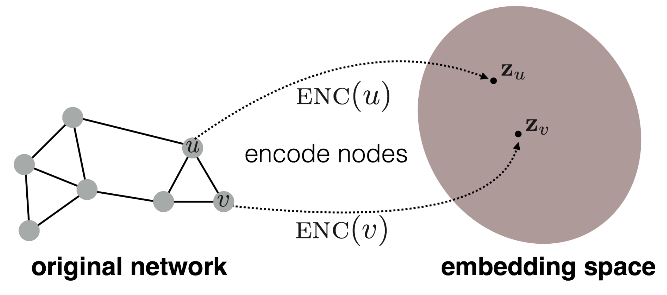
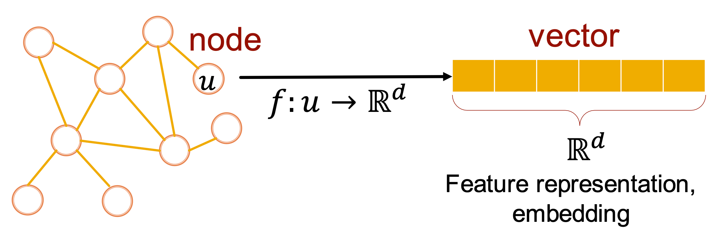
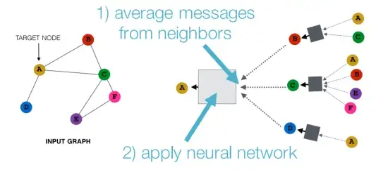
Graph Neural Networks (GNNs)

Slide 4
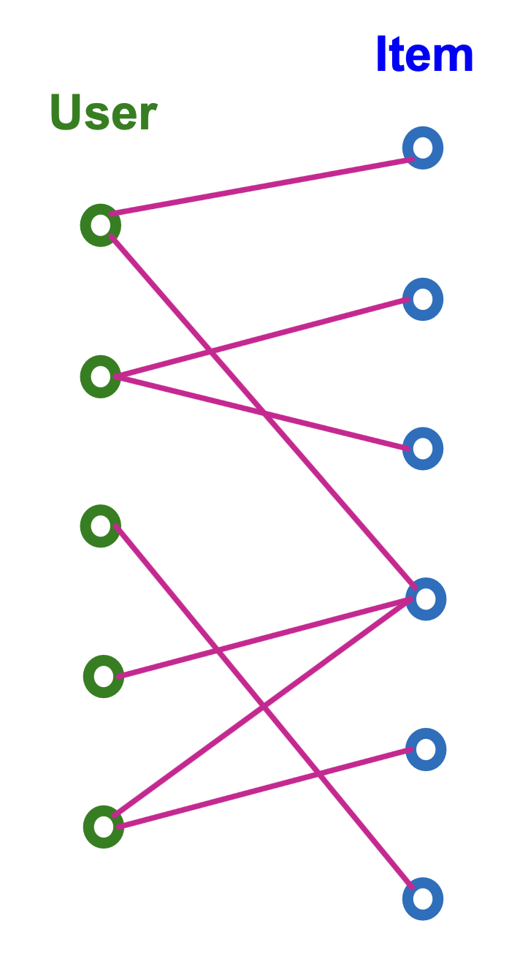
Why Graph Neural Network for Recommender Systems
GNN techniques have been demonstrated to be powerful in representation learning for graph data in various domains
Most of the data in recommendation has essentially a graph structure
- For instance, the user-item interaction data can be represented by a bipartite graph between the user and item nodes, where the link represents the interaction between the corresponding user and item
GNN can explicitly encode the crucial collaborative signal of user-item interactions to enhance the user/item representations through the propagation process
Notes:
Improve the conventional collaborative filtering models (i.e. Matrix Factorization) by explicitly modelling the graph structure using GNNs.

Slide 5
Categories of GNN-Based Recommendation
Shiwen Wu, Fei Sun, and Wentao Zhang, Xu Xie, Bin Cui. 2022. Graph Neural Networks in Recommender Systems: A Survey. ACM Comput. Surv. 37, 4, Article 111 (April 2022), 37 pages. https://doi.org/10.1145/1122445.
Social Recommendation (Main Focus)
- With the emergence of online social networks, social recommender systems have been proposed to utilize each user’s local neighbors’ preferences to enhance user modeling
Sequential Recommendation
- Sequential recommendation predicts users’ next preferences based on their most recent activities, which seeks to model sequential patterns among successive items, and generate accurate recommendations for users
Taxonomy
KG-based Recommendation
- Social network that reflects relationships between users, is utilized to enhance user representation, while knowledge graph that expresses relationships between items through attributes, is leveraged to enhance the item representation
USER-ITEM Collaborative Filtering
- Given the user-item interaction data, the basic idea of user-item collaborative filtering is essentially using the items interacted by users to enhance user representations and using the users once interacted with items to enrich item representations
To be noticed: These categories are specific research areas to choose from, but they are not separate from each other. For example, in the field of social recommendation that we will study, the knowledge and models of the User-item matrix and sequential recommendation will also be involved.

Slide 6
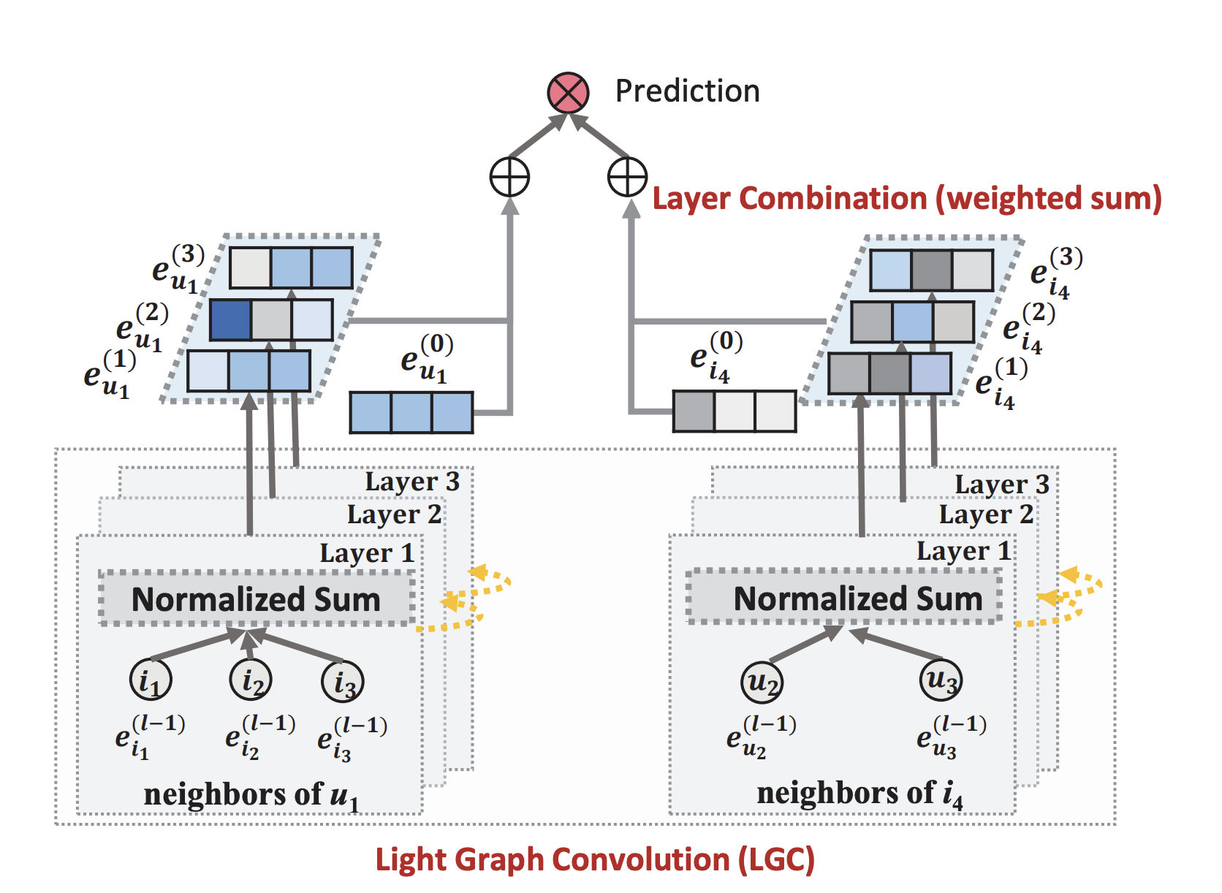
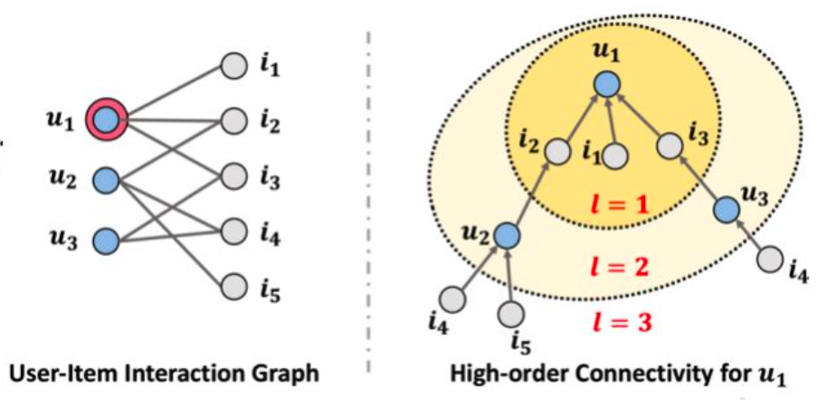
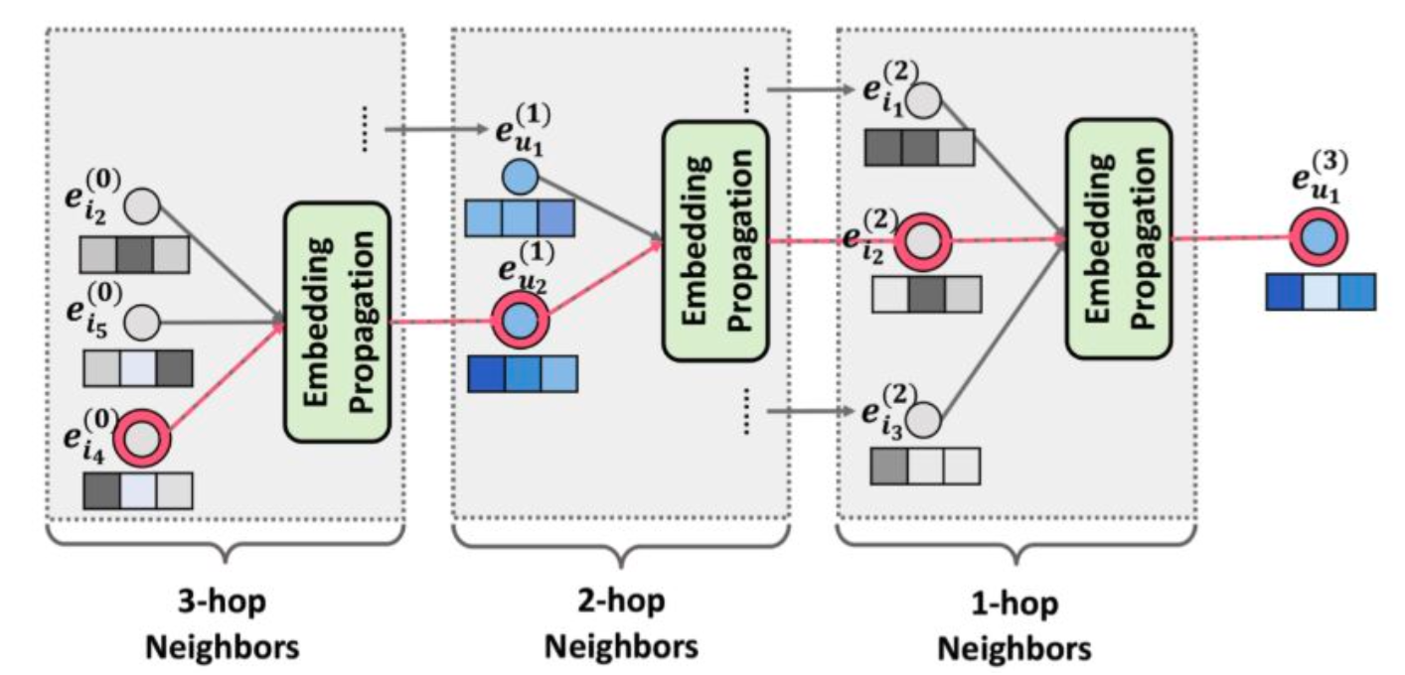
Neural Graph Collaborative Filtering (NGCF) and LightGCN
Xiang et al., 2019, In SIGIR
Idea:
Collaborative filtering via higher-order connectivity

Slide 7
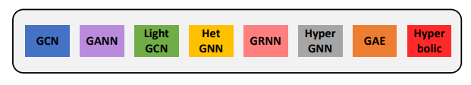
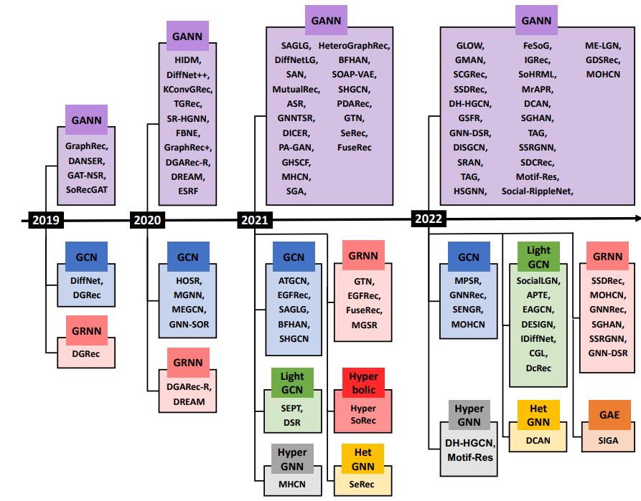
Existing Models and the Categories in SocialRS
Shiwen Wu, Fei Sun, and Wentao Zhang, Xu Xie, Bin Cui. 2022. Graph Neural Networks in Recommender Systems: A Survey. ACM Comput. Surv. 37, 4, Article 111 (April 2022), 37 pages. https://doi.org/10.1145/1122445.
The main principle of these models is to deal with the two issues:
Influence of Friends. Do friends have equal influence? If not, how to distinguish the influence of different friends?
Preference Integration. Users are involved in two types of relationships, i.e., social relationships with their friends and interactions with items. How to integrate the user representations from the social influence perspective and interaction behavior?
All these models deal with social recommendation problems, and most of them incorporate many other models to attain a better performance such as attention models / LSTM models and so on. They may have pros and cons and could be applied to solve different problems under different scenarios, which will be discussed later.

Slide 8
Anticipation of the project
.
Compare lightGCN and the most basic models, and identify which model components can significantly improve the performance of the model
Model components known may improve model performance include attention mechanism, sequential mechanism (such as adding LSTM model), etc
Among these mechanisms, there are some mechanisms that can solve some specific problems. For example, lightGCN model can alleviate the problem of scalability. We will try to summarize
If Possible: Modify the existing models or Construct new models to solve a certain problem, such as the cold-start problem in recommender systems
This is based on the assumption that we can already understand and have the ability to make use of some of the existing models
Also, this requires us to have a deep understanding of the existing models, including their principles, advantages and disadvantages

Slide 9
Proposed Directions for Further Research
.
Scalability
Optimization for Cold-Start Scenarios
In industrial recommendation scenarios where the datasets include billions of nodes and edges while each node contains millions of features, it is challenging to directly apply the traditional GNN due to the large memory usage and long training time.
To deal with the large-scale graphs, there are two mainstreams: one is to reduce the size of the graph by sampling to make existing GNN applicable; another is to design a scalable and efficient GNN by changing the model architecture.
Existing methods focus on modeling the user-item interaction graph. The inherent drawback of such methods is that their performance is bound to the density of the interactions, which is however usually of high sparsity. More importantly, for a strict cold start user/item that neither appears in the training data nor has any interactions in the test stage, such methods are unable to learn the preference embedding of the user/item since there is no link to this user/item in the graph.
The two common methods are: pre-trained GNN model or learning on the distribution of attributes

